Slide 1
Mobile Application Security Assessment
Presented by: Akbar Hussain

Slide 2
Security Assessment of Bank Application
The Mobile application known as InsecureBank this vulnerable Android application is also named as "InsecureBankv2". This vulnerable Android application is designed specifically for security enthusiasts and developers interested in exploring and understanding common security vulnerabilities within Android applications. InsecureBankv2 provides a hands-on learning environment for testing and identifying weaknesses, making it an invaluable resource for enhancing application security knowledge.

Slide 3
Tool For Assessment
MobSF is an automated, all-in-one framework for penetration testing mobile applications across Android, iOS, and Windows platforms. It offers robust capabilities for static analysis, dynamic analysis, malware analysis, and web API testing.

Slide 4


Slide 5
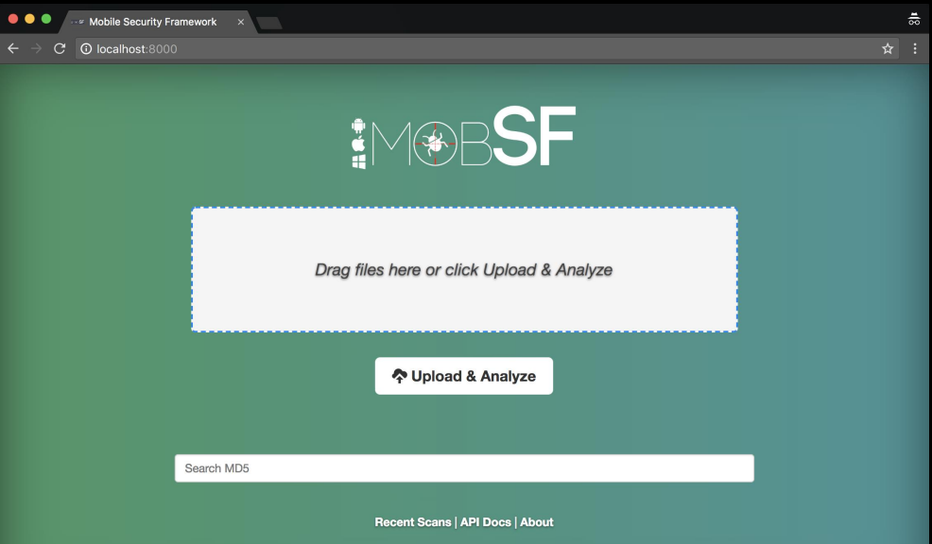
Methodology
MobSF (Mobile Security Framework) user interface, designed for analyzing mobile application security.

Slide 6
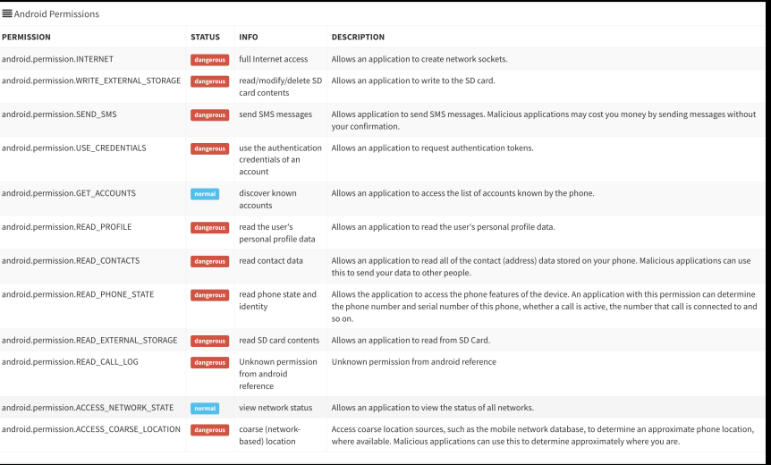
App Permission Details

Slide 7
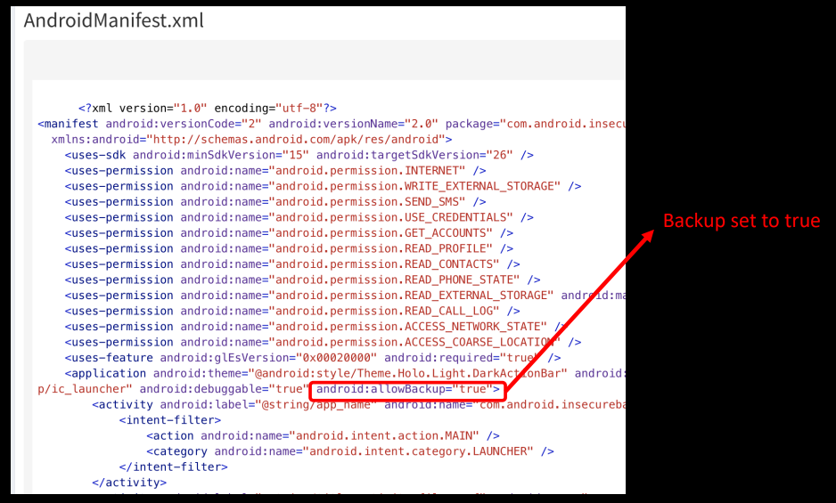
Insecure Storage
The application demonstrates insecure cookie storage, where cookie data is retained without proper expiration policies. This vulnerability could allow an attacker to hijack an active session. This is a big storage vulnerability.

Slide 8
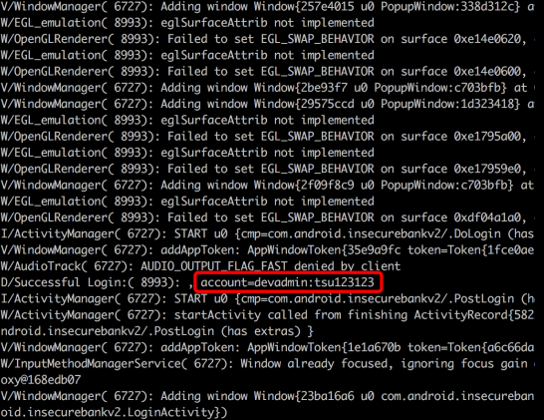
Leaked Sensitive Information
A log from an application revealing a significant security issue where sensitive information, specifically an account identifier (account=devadm:tsu123213), has been leaked during communication. The log includes warnings related to window management and OpenGL rendering, indicating performance concerns.

Slide 9
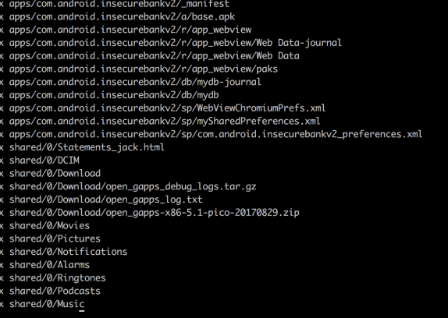
Backup Files ( Unencrypted)
Convert these into readable files

